Slide 1
Introduction to UML
History, Need and Tools

Slide 2
Course Introduction
Introduction
Basics
Structural Modeling
Behavioral Modeling

Slide 3
Introduction
History
Common Language
Tools

Slide 4
History
The 1970s and 1980s
Largely Structured Analysis and Design
The Late 1980s and 1990s
OOA&D
Multiple modeling techniques
No Standard
□ 1997
OMG – Submissions for Standard
Rational submitted UML 1.0
OMG created ‘standardized’ UML
November 1997 Rational released UML 1.1

Slide 5
The 3 Amigos
1994
Jim Rumbaugh joined Grady Booch at Rational
1995
Rational bought Objectory and Ivar Jacobson joined
Self Declared Standard

Slide 6
UML Today
Current – 2.4.1
August 2011
Upcoming – 2.5
Beta, October 2012

Slide 7

Communication Problems

Slide 8
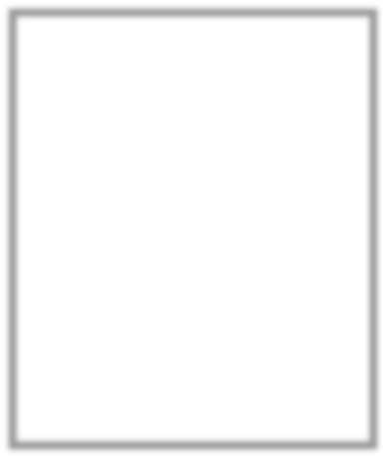



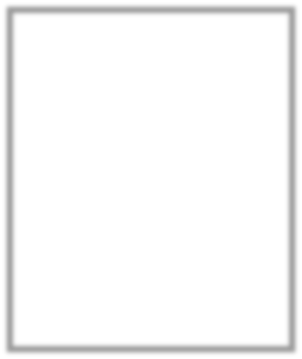
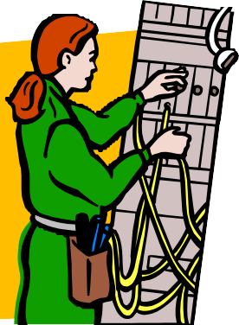
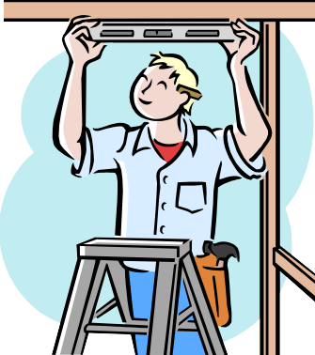
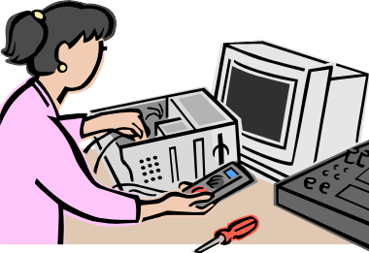
Common Users of UML Diagrams
Product Owner
Business Analyst
Architec t
Operations
Quality Assurance
Developer

Slide 9
Same Thing – Different Language
Suunnittelen ohjelmisto
म� सॉफ्टवेयर fडजाइन
Ich habe design software
Ik ontwerp software
Progettazione software
I design software
소프트웨어 디자인
Дизайн софтуер
Tôi thiết kế phần mềm
Je conçois des logiciels
Diseño software
Я розробки програмного забезпечення

Slide 10
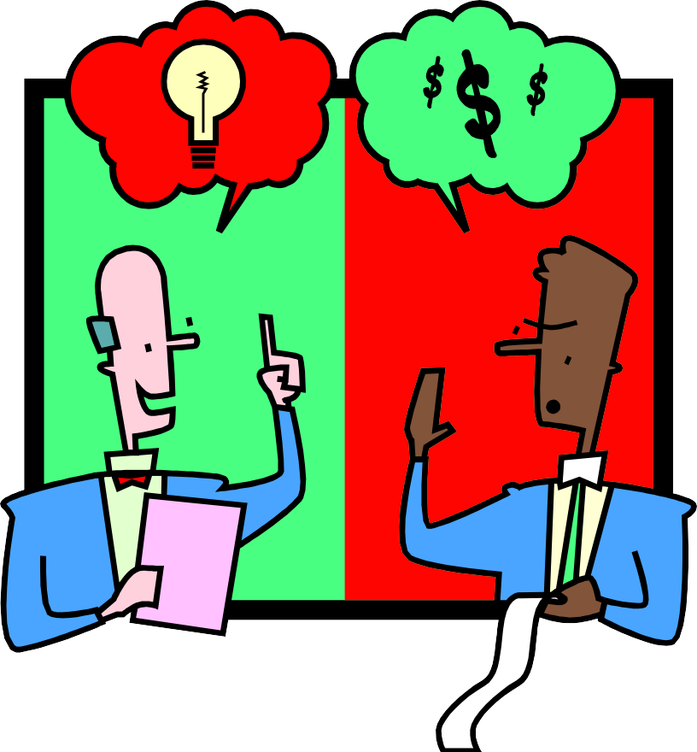
Business?

Slide 11
Technology
Lisp
Python
Smalltalk
C/C++
XSLT
Prolog
DML
F#
JavaScript
C#
DDL
Scala
SOA
Java
SQL
TypeScript
Pascal
VB.NET
Cobol

Slide 12
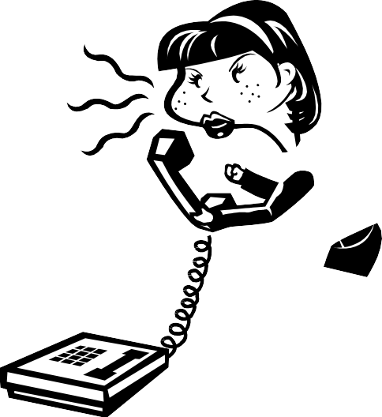


Design Meetings

Slide 13



Development Methods
Waterfall
Iterative
Plan
Plan
Build
Deploy
Build
Test
Deploy
Test

Slide 14
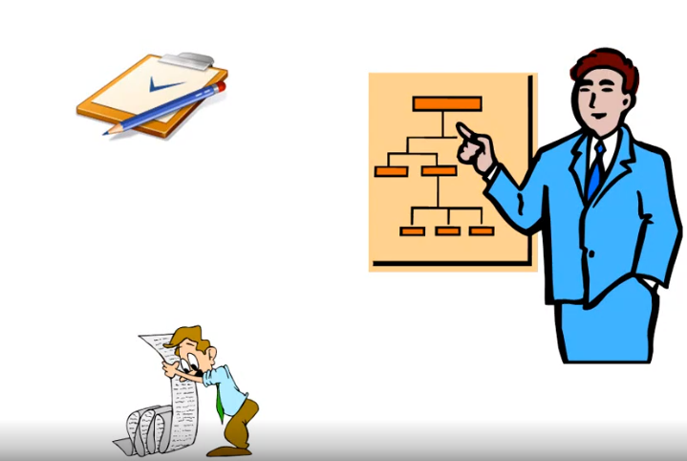
Methods vs. Models

Slide 15
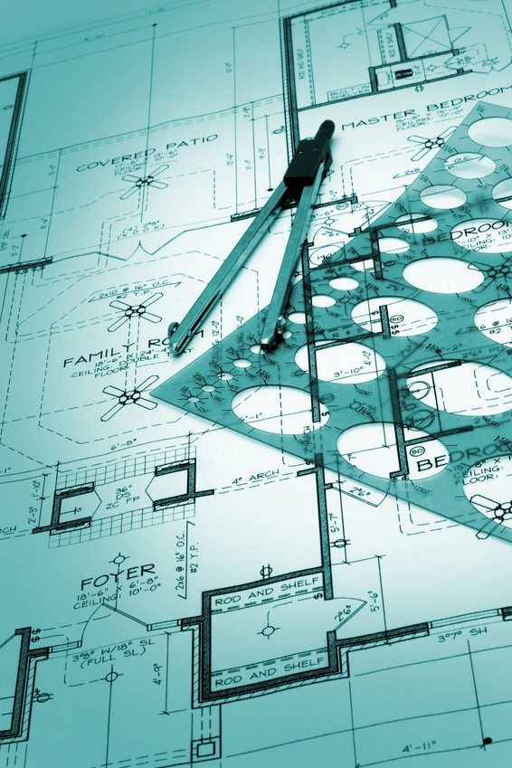
Formal Tools

Slide 16
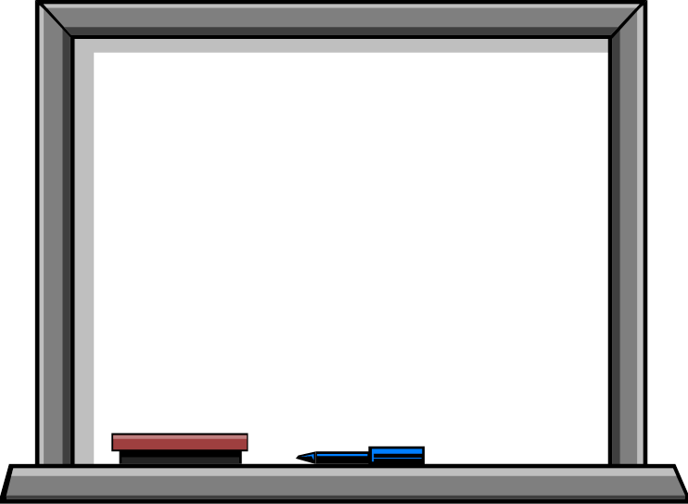
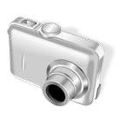
Informal Tools

Slide 17
Summary
UML Standard
□ UML 2.4.1
Communication
Precise
Standard
Common
Tools
Formal
Informal

